Slide 1
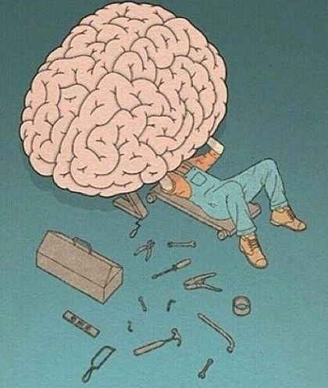
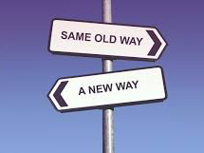
Habits, Depression, & Fixes
Depression & Decision Making
Spring 2017
Clarissa Staton

Slide 2
What is a habit? What is a decision?
Habit: a settled or regular tendency or practice, especially one that is hard to give up.
Synonyms: custom, routine, pattern, convention
Decision: a conclusion or resolution reached after consideration.
Synonyms: resolution, conclusion, settlement, commitment

Slide 3
So.. Is a habit a decision?

Slide 4
Why is a habit different than a decision (goal-directed behavior) ?
Decision
1. Reflects knowledge of the relationship between an action (or sequence of actions) and its consequences.
2. Outcome should be motivationally relevant or desirable at the moment of choice.
Habit
1. Stamped by past reinforcement
2. Separated from the current value of an associated outcome
Dolan & Dayan. 2013

Slide 5
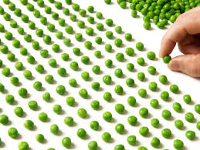
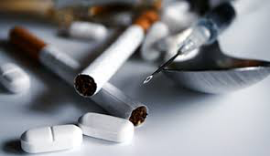
Disorders involving habits
Obsessive Compulsive Disorder (OCD)
Over-reliance on habitual circuitry
Other Diseases of compulsivity
Tend to lean learning habits
Addiction
**All known to have some relation to the Orbitofrontal Cortex (OFC) brain region**

Slide 6
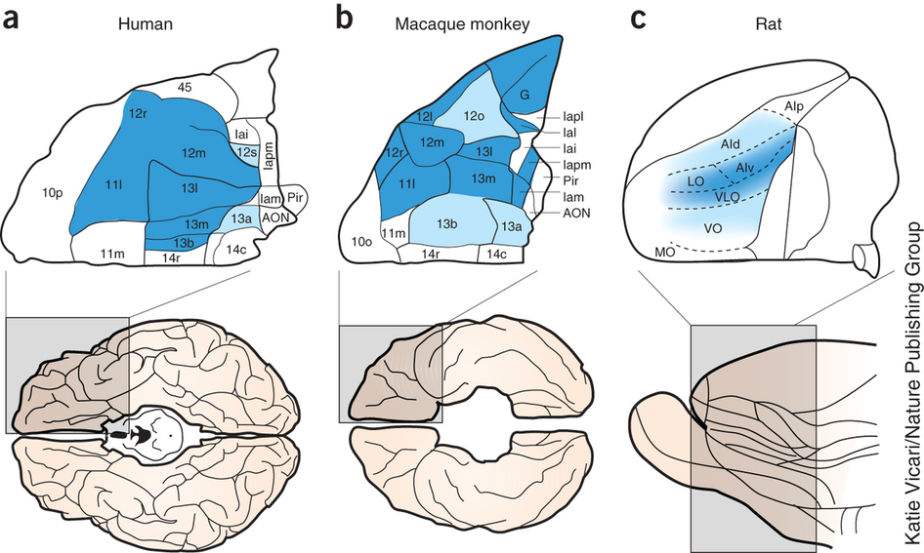
Orbitofrontal Cortex
Stalnaker et al., 2015
Notes:
Part of the prefrontal Cortex--

Slide 7
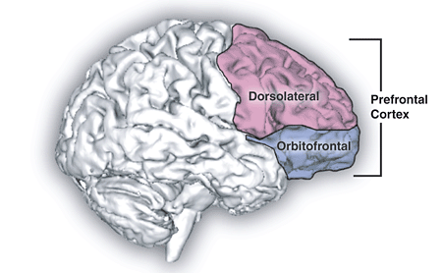
Orbitofrontal Cortex
Part of prefrontal cortex
Responsible for;
Value of reinforcers
Decision making
Expectation

Slide 8
Based on diseases & known functions of OFC, obviously a connection between habits & decision making

Slide 9
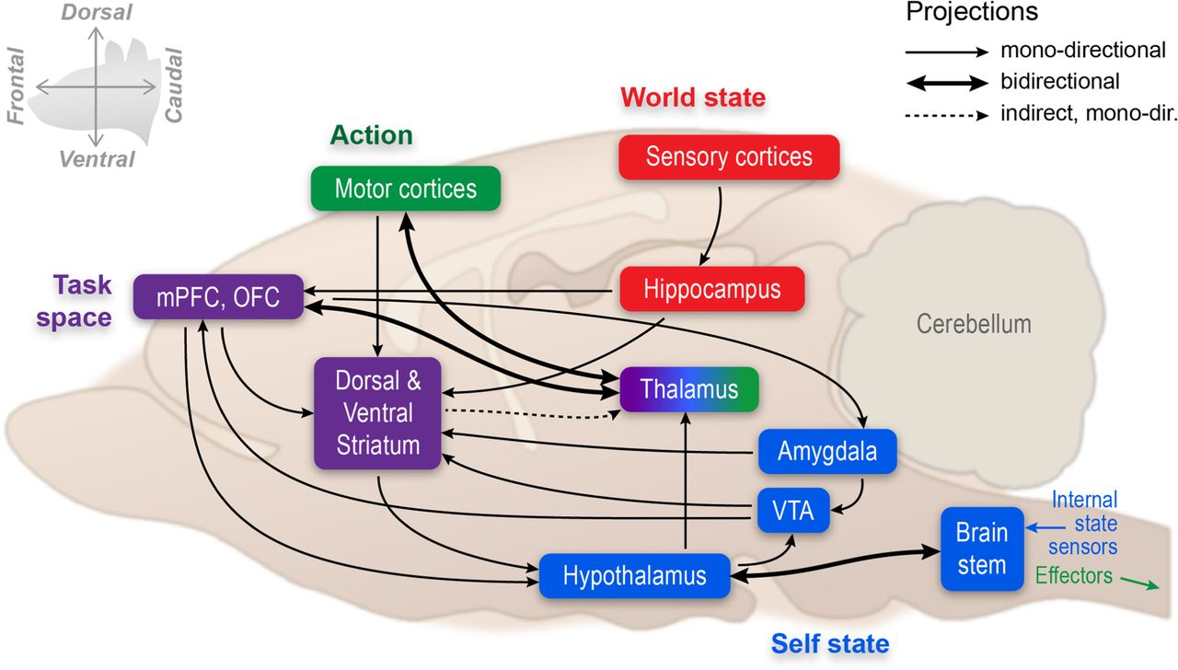
Orbitofrontal Cortex
Verschure et al., 2014
Notes:
Projects too;
Hippocampus
Amygdala
Hypothalamus
Striatum
Thalamus
Cortex

Slide 10
But which projection is important for habit formation & goal-directed actions?
Notes:
Well due to previous findings, it was thought to be the Dorsal Striatum due to its involvement in goal-directed and habitual actions.

Slide 11
Striatum
Striatum
Dorsal
Caudate
Putamen
Ventral
Nucleus Acumbens
Composed of GABA cells

Slide 12
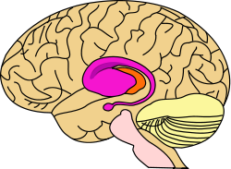
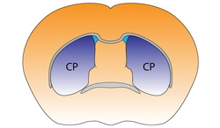
Dorsal Striatum
Roles in;
Motor/action planning
Reward system
Decision-making

Slide 13
So what what are potential endogenous mechanisms that could modulate these areas involved in habit formation?

Slide 14
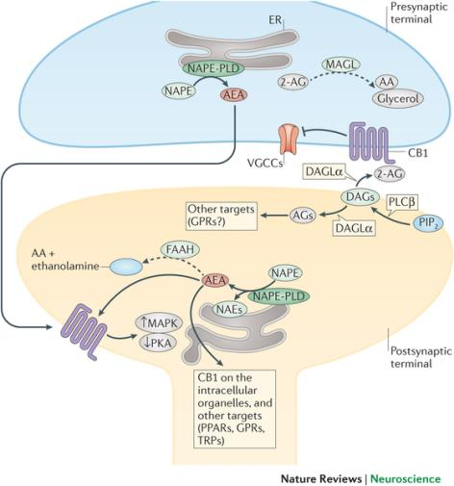
Endocannabinoids
Lipid based neuromodulator/hormone molecule
Synthesized on demand
2 primary molecules
AEA
2-AG
Cliff15Endocannabinoids.ppt

Slide 15
Endocannabinoids
2 Classic Receptors
CB₁: high density in central nervous system
CB₂: low density in CNS; high peripherally
Cliff15Endocannabinoids.ppt

Slide 16
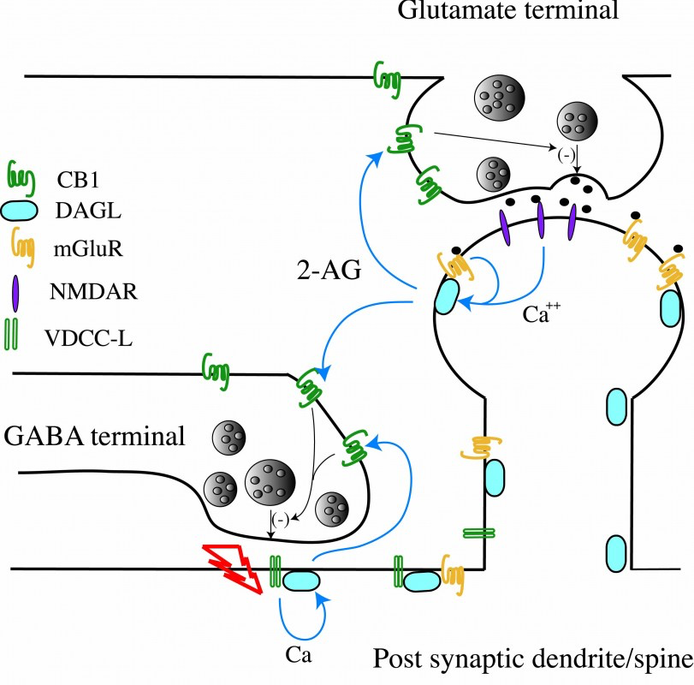
Endocannabinoids: CB₁ Receptors
High density
Presynaptic on GABA and Glu neurons
Binds AEA, 2-AG, Δ9THC
Triggers G_{i/o} protein →
Inhibits Glu or GABA release
Cliff15Endocannabinoids.ppt

Slide 17
Endocannabinoid Modulation of Orbitostriatal Circuits Gates Habit Formation
Christina M. Gremel, Jessica H. Chancey, Brady K. Atwood, Guoxiang Luo, Rachael Nerve, Charu Ramakrishnan, Kari Deisseroth, David M. Lovinger, and Rui M. Costa

Slide 18
Materials & Methods: What was their behavioral paradigm?
Train Animals
(either RR or RI)
Test for habit or goal-directed behavior
(Outcome Devaluation Testing)

Slide 19
Materials & Methods: RR & RI Training Schedules
Random Ratio (RR): Reward given after “x” amount of lever presses
Said to produce goal-directed behavior
Random Interval (RI): Reward given after “x” amount of time
Said to produce habitual behavior

Slide 20
Materials & Methods: RR & RI Training Schedules
Figure 1

Slide 21
Materials & Methods: Why do these training schedules work?
Random Ratio (RR):
Outcome becomes equally available with/without a certain number of lever presses
Random Interval (RI):
Outcome only becomes available after amount of time
Dolan & Dayan. 2013

Slide 22
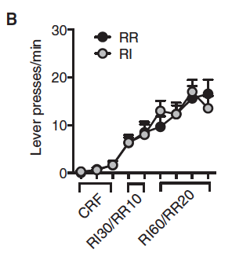
Materials & Methods: RI and RR Training
RR & RI produce same amount of lever presses
Figure 1

Slide 23
Materials & Methods: What was their behavioral paradigm?
Train Animals
(either RR or RI)
Test for habit or goal-directed behavior
(Outcome Devaluation Testing)

Slide 24
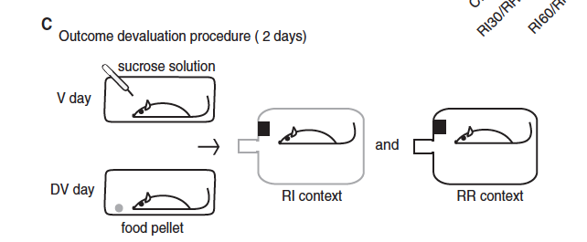
Materials & Methods: Outcome Devaluation Testing
Which was first was randomized
Train first→ then Devaluation
Figure 1

Slide 25
Materials & Methods: Outcome Devaluation Testing
Valued Day (V day):
Not fed prior to being tested
Devalued Day (DV day):
Fed prior to being tested
⬇ motivation for the food (lever press)

Slide 26
Materials & Methods: How does outcome devaluation testing tell you anything about a habit?
If animal still wants food on de-valued day (after already had food)→ than pressing out of habit, not want of food.
Because why would you still want food if you already ate?!?
Unless it’s a habit.

Slide 27
Materials & Methods: Valued vs. Devalued State
RR Showed significantly less lever presses on De-valued day.
RR=goal directed
RI=habit
Figure 1

Slide 28
So we have a behavioral paradigm established… Now what?
Remember Endocannabinoids!?!?

Slide 29
What was hypothesized?
CB1 receptor activation on OFC projection neurons could be one of the mechanisms gating the shift from goal-directed to habitual action control.

Slide 30
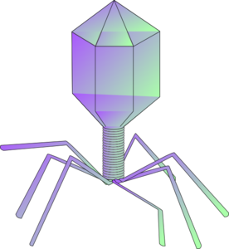
Materials & Methods: Viral Constructs & Gene Transfer
Upstream
Enhancer
Downstream
Enhancer
Promoter:
Which cell you will see transcription in
Gene
Marker
pAAV-DIO-hChR2(H134R)-EYFP-WPRE-pA
Notes:
1)First thing you do is you manipulate a DNA strand, insert a promoter, with the gene you want to transcribe, then add a marker so you know you can find it. You then insert it into a virus and you get a name like…..
Then you can insert it ito the mouse.
So the first thing they did was inject a lentivirus that expressed mCherry driven by an MCH gene promoter→ this marked the MCH neurons 2A &B1)→MCH found in 98.7% of mCherry labeled cells
Figure 2B5→shows that MCH cell function was unaffected by viral infection
Next they inserted a channel rhodopsin into orexin neurons → in MCH neurons – activation of OH caused a reduction in the MCH neuron activity

Slide 31
Materials & Methods: Deletion of OFC CB₁ Receptors
So first, delete CB₁ receptors in OFC
Given one of two types of injections
AAV9-Ef1a-Cre-eGFP=widespread CB₁r Deletion
AAV9-CamKII-Cre-eGFP=Cb1r deletion on OFC Projection Neurons
Figure 2

Slide 32
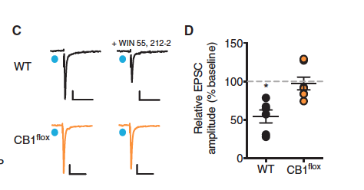
Materials & Methods: Deletion of OFC CB₁ Receptors
It worked!
Connectivity between OFC & DS
oEPSCs
oEPSC= optically evoked excitatory postsynaptic currents
Figure 2
Notes:
Gave a CB1 agonist (WIN55,212) to test light-evoked excittatory transmision.

Slide 33
Materials & Methods: Deletion of OFC CB₁ Receptors
Injection of AAV9-Ef1a-Cre-eGFP or AAV9-CamKII-Cre-eGFP
Figure 2

Slide 34
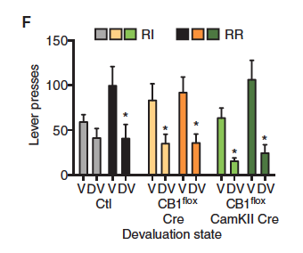
Results: Deletion of OFC Cb1 Receptors
Deletion of OFC CB₁ receptors→ attenuation of habit
Especially in CamKII neurons
Figure 2
Notes:
In control→ we see a difference Between RR & RI schedules (RI no sig difference between V & DV)
When delete CB1→no longer a difference between RR & RR (especially when you look at the CAMKII, in fact these pressed even less than control)

Slide 35
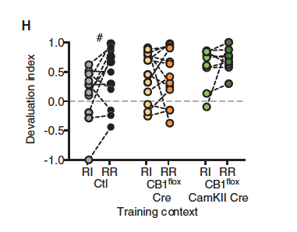
Results: Deletion of OFC Cb1 Receptors
Deletion of OFC CB₁ receptors→ attenuation of habit
Especially in CamKII neurons
What other explanations are there for this
Figure 2
Notes:
In control→ we see a difference Between RR & RI schedules (RI no sig difference between V & DV)
When delete CB1→no longer a difference between RR & RR (especially when you look at the CAMKII, in fact these pressed even less than control)
* what could explain this? Could it be lack of motivation?

Slide 36
Ok cool.. So CB₁ receptors cause formation of habit-action control (especially in OFC projection neurons)

Slide 37
But remember… OFC projects to many areas of the brain.. Which area projection is important for habit-action control?

Slide 38
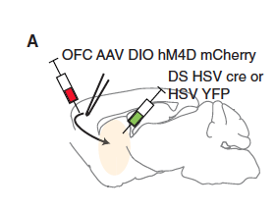
Materials & Methods: Attenuation of OFC-DS Projection Activity
Previous work gave suggestion to Dorsal Striatum.
Knocked out this pathway via…..
1st: DS HSV-1 cre or HSV-1 YFP
2nd: OFC AAV-DIO-hM4D-mCherry
Figure 3

Slide 39
Materials & Methods: Attenuation of OFC-DS Projection Activity
DS HSV-1 cre or HSV-1 YFP: knockout CB₁
So can control which inhibitory transmission is being used
OFC AAV-DIO-hM4D-mCherry: to insert alternative inhibitory receptor
hM4D=inhibitory G_{i} –coupled muscarinic 4 receptor)
Activated by CNO
Figure 3
Notes:
DIO is synapsin promoter=nonspecific activation

Slide 40
Materials & Methods: Attenuation of OFC-DS Projection Activity
1st: DS HSV-1 cre or HSV-1 YFP
2nd: OFC AAV-DIO-hM4D-mCherry
Together, this leads to expression of hM4D in OFC-DS only
Figure 3
Notes:
DIO is synapsin promoter=nonspecific activation

Slide 41
Materials & Methods: Attenuation of OFC-DS Projection Activity
It worked!
Expression of hM4D in OFC-DS only
CNO blocked action potential
Figure 3

Slide 42
Materials & Methods: Attenuation of OFC-DS Projection Activity
Injection of DS HSV-1 cre or HSV-1 YFP
& AAV-DIO-hM4D-mCherry
IP CNO application
Figure 3

Slide 43
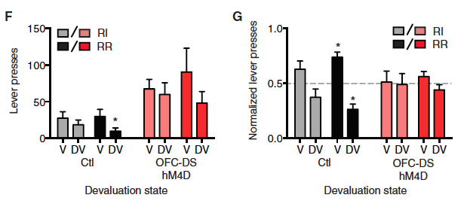
Results: Attenuation of OFC-DS Projection Activity
Inhibiting OFC-DS pathway → attenuation of habit formation
⬆ locomotor activity was ruled out
Figure 3

Slide 44
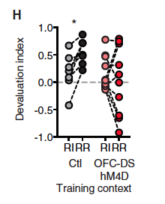
Results: Attenuation of OFC-DS Projection Activity
Inhibiting OFC-DS pathway → attenuation of habit formation
But what do you think about the major reduction in RR of the hM4D mice?
Figure 3

Slide 45
Materials & Methods: Attenuation of OFC-DS Projection Activity
But.. Systemic CNO administration could have attenuated activity of OFC-DS neurons in other downstream areas
So decided to infuse CNO directly into the medial DS
Figure 4

Slide 46
Materials & Methods: Attenuation of OFC-DS Projection Activity
So decided to infuse CNO directly into the medial DS
This also worked
Figure 4

Slide 47
Materials & Methods: Attenuation of OFC-DS Projection Activity
Injection of DS HSV-1 cre or HSV-1 YFP
& AAV-DIO-hM4D-mCherry
Intracranial CNO application
Figure 3

Slide 48
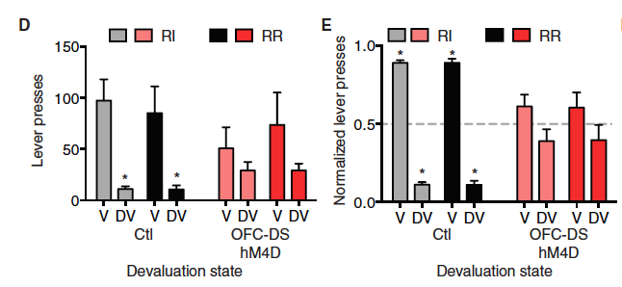
Results: Attenuation of OFC-DS Projection Activity
Attenuation of OFC-DS activity→ no difference between goal and habit in both training contexts
Stress caused RI to not produce habitual behavior
Figure 4

Slide 49
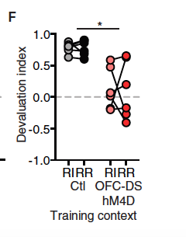
Results: Attenuation of OFC-DS Projection Activity
Comparison of devaluation index showed attenuation of OFC-DS pathway leaves mice reliant on habit
Figure 4

Slide 50
So now we know; 1. CB₁ receptors important for habit formation 2. OFC-DS connection important for goal-directed behavior

Slide 51
Hmmm…. But what about the CB₁ receptors on the OFC-DS connection specifically??

Slide 52
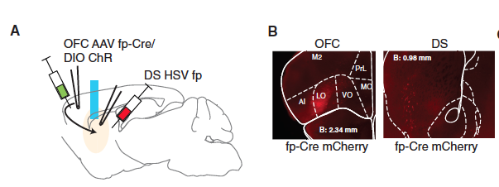
Materials & Methods: CB₁ Receptor-Mediated Attenuation of OFC-DS Activity
To determine this, delete CB₁ receptor activity is OFC-DS pathway
Delete CB₁ receptors via taking CB₁^{flox} mice and inject with;
1st: HSV-1 fp
2nd AAV8-Ef1a-FD-mCherry-P2A-Cre
Figure 5
Notes:
So with the floxed mice, the cre will target only those floxed cells to delete those

Slide 53
Materials & Methods: Attenuation of OFC-DS Projection Activity
1st: HSV-1 fp
2nd AAV8-Ef1a-FD-mCherry-P2A-Cre
Together, this limited the Cre-recombinase expression to OFC-DS neurons and CB₁ deletetion in OFC-DS neurons of the floxed mice
Figure 5
Notes:
DIO is synapsin promoter=nonspecific activation

Slide 54
Materials & Methods: CB₁ Receptor-Mediated Attenuation of OFC-DS Activity
This also worked!
CB₁ was deleted
Successful Cre-Recombinase activity
Successful deletion of CB₁ receptors in terminals OFC-DS neurons
Figure 5

Slide 55
Materials & Methods: CB₁ Receptor-Mediated Attenuation of OFC-DS Activity
Injection of HSV-1 fp & AAV8-Ef1a-FD-mCherry-P2A-Cre
Figure 5

Slide 56
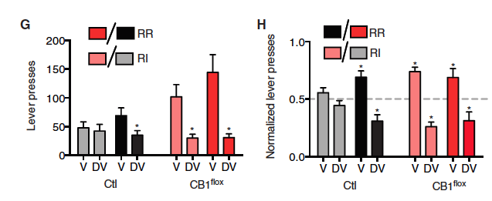
Results: CB₁ Receptor-Mediated Attenuation of OFC-DS Activity
Deletion of CB₁ in OFC-DS pathway→ attenuation of habitual control
Figure 5

Slide 57
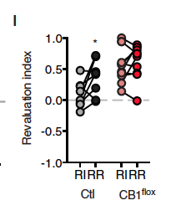
Results: CB₁ Receptor-Mediated Attenuation of OFC-DS Activity
Deletion of CB₁ in OFC-DS pathway→ attenuation of habitual control
Shift between controls but not CB₁ deleted
Suggests shift in degree of goal-directedness
Figure 5

Slide 58
So now we know; 1. CB₁ receptors important for habit formation 2. OFC-DS connection important for goal-directed behavior 3. Inhibition of OFC-DS circuit via CB₁ caused habitual action control

Slide 59
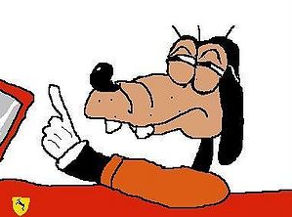
But wait… how does habit control fit with depression?

Slide 60
Depression is Co-Morbid with habit behaviors
Depression is often comorbid with
Personality disorders
Addiction
OCD
Melartin et al., 2002
Fineberg et. al, 2002
Notes:
All of these disorders tend to have a habitual over-reliance

Slide 61
What about CB₁ and depression?

Slide 62
Depression-like phenotype following chronic CB₁ receptor antagonism
Chad E. Beyer, Jason M. Dwyer, Michael J. Piesla, Brian J. Platt, Ru Shen, Zia Rahaman, Karen Chan, Melissa T. Manners, Tarek A. Samad, Jeffrey D. Kennedy, Brendan Bingham, Garth T. Whiteside.

Slide 63
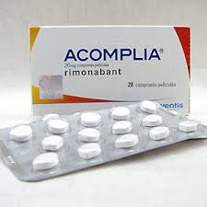
Why look at CB₁ and Depression?
Rimonabant…
What is Rimonabant?
CB₁ receptor antagonist
Originally on the market for obesity. But noticed adverse psychiatric effects after long-term use.
Depressed mood disorders
Anxiety
Suicidal ideation

Slide 64
Why look at CB₁ and Depression?
Other people have looked at CB₁ (most specific to Rimonabant) and depression.
Found conflicting results..
Some say is anxiogenic
Some say is anti-depressive/anxiolytic
Hmmm….
So this group thought it would be importnat to study the link further

Slide 65
What was hypothesized
Long-term treatment with rimonabant would be accompanied by a depression-like phenotype.

Slide 66
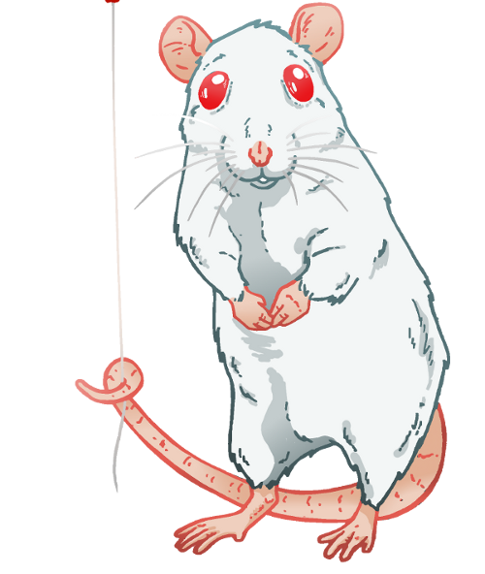
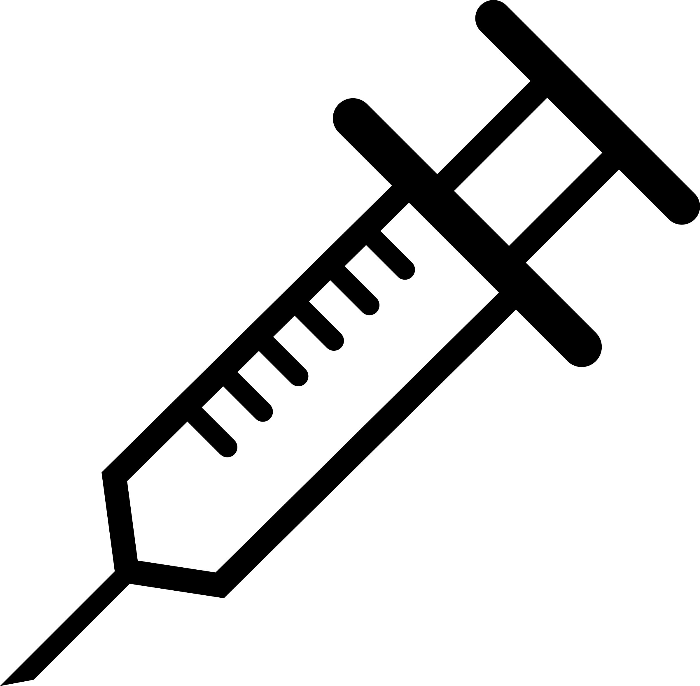
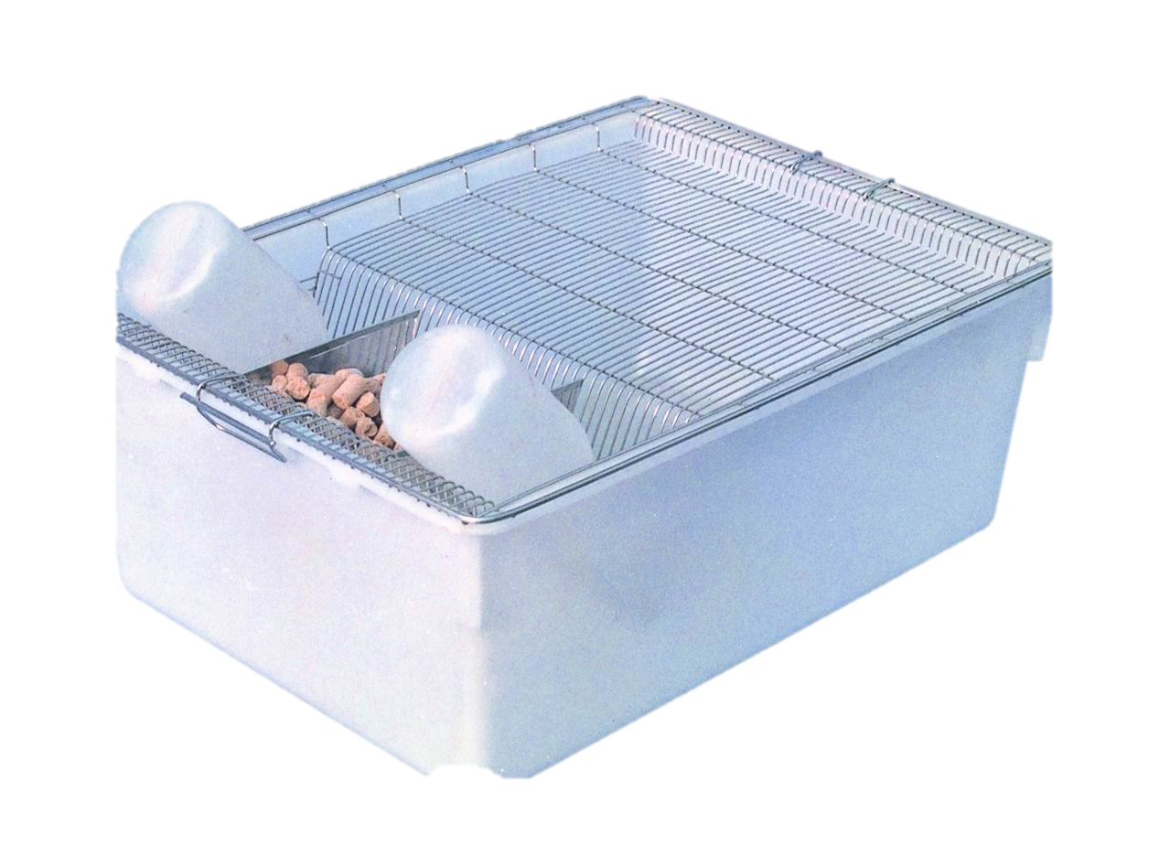
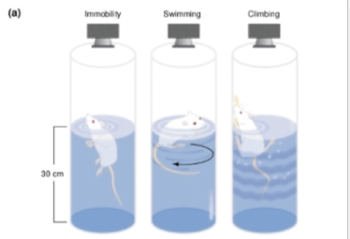
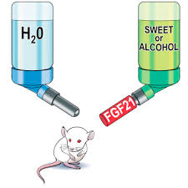
Materials and Methods
Controls
Rimonabant
(21 Days)
0.3 or 10 mg/kg
Or
Chronic
Mild Stress (CMS)
Or
Forced Swim Test (FST)
Sucrose Consumption
Cryan et al., 2002
Talukdar et al., 2016
Notes:
Sucrose consumption=measure of anedonia

Slide 67
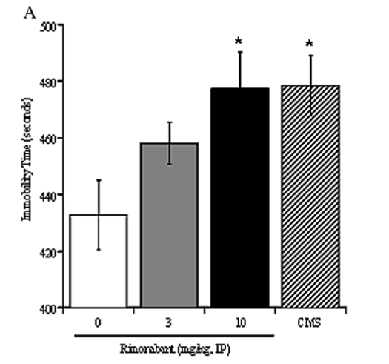
Results: FST
⬆ Rimonabant ➔ ⬆Immobility
Similar to CMS
Depression-like phenotype

Slide 68
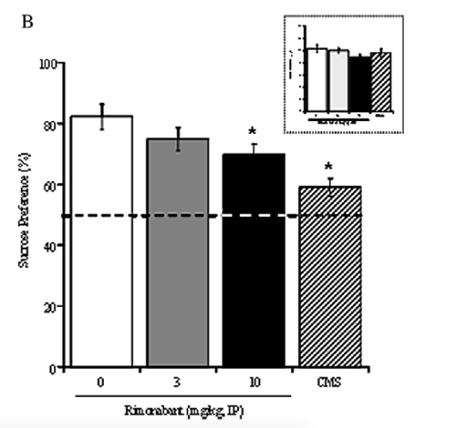
Results: Sucrose Consumption Test
⬆ Rimonabant ➔ ⬇preference➔⬇anhedonia
Similar to CMS
Depression-like phenotype

Slide 69
So we now know..
Antagonizing CB₁R ➔ depression-like phenotype
Remember: this is systemic CB₁ antagonism

Slide 70
This leads us to think that there could be potential mechanisms to alleviate issues involving habit formation and depression via CB₁ receptors? Perhaps with striatal pathway?

Slide 71
Voluntary Exercise and Sucrose Consumption Enhance Cannabinoid Cb1 Receptor Sensitivity in the Striatum
Valentina De Chiara, Francesco Errico, Alessandra Musella, Silvia Rossi, Giorgia Mataluni, Lucia Sacchetti, Alberto Siracusano, Maura Castelli, Francesca Cavasinni, Giorgio Bernardi, Alessandro Usiello, and Diego Centonze

Slide 72
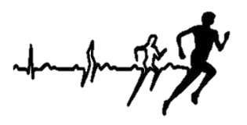
Exercise & Sucrose Consumption
Has rewarding/reinforcing properties
Via modulation of striatal neuron activity
It is possible that could mimic the effect of certain drugs on cannabinoid mediated control of striatal synapse transmission

Slide 73
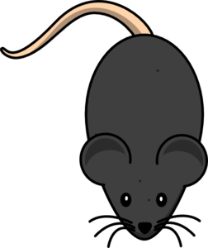
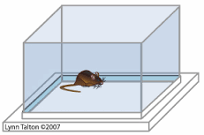
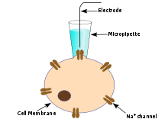
Materials and Methods
Controls
Running Wheel
(1,3,7,15, or 30 days)
Sucrose Preference
Or
Or
Drugs/No Drugs
Electrophysiology
Stress Tests
(Social Aggression, Sensory Contact Open Field)
Notes:
Sucrose consumption=measure of anedonia

Slide 74
Materials & Methods: Drugs
HU210=CB₁ receptor agonist
AM251= CB₁ receptor antagonist
Baclofen= GABA_{B} receptor agonist
DHPG=mGlu receptor agonist

Slide 75
Materials & Methods: Electrophysiology
Increase Frequency➔ increased likelihood of neurotransmitter release
Pre-synaptic
Increase Amplitude→ more neurotransmitter received
Post-synaptic

Slide 76
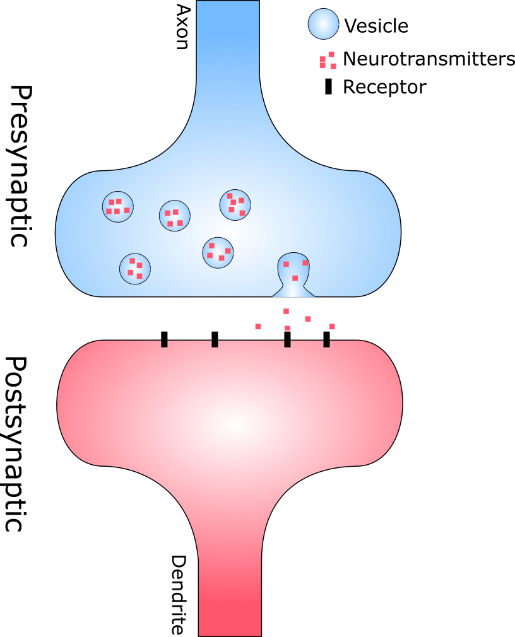
Materials & Methods: Electrophysiology
Increase Frequency➔ increased likelihood of neurotransmitter release
Pre-synaptic
Increase Amplitude→ more neurotransmitter received
Post-synaptic
GABA

Slide 77
Results: Effects of Sucrose on CB₁ Agonist on Striatal sIPSCs
CB₁ agonist caused ⬇ in IPSC frequency was normal after sucrose consumption
Effects potentiated after 7 & 15 days
Figure 1

Slide 78
Results: Effects of Sucrose on CB₁ Agonist on Striatal sIPSCs
CB₁ antagonist prevented depressant action of CB₁ agonist in control & sucrose mice
Figure 1

Slide 79
Results: Effects of Running Wheel on CB₁ Agonist on Striatal sIPSCs
Running Wheel has same effect as sucrose
Figure 1

Slide 80
Results: Effects of Running Wheel on CB₁ Agonist on Striatal sIPSCs
Running Wheel has same effect as sucrose
Figure 1

Slide 81
What does this mean? - CB receptors adapt during environmental manipulations - and.. These effects are reversible

Slide 82
This could be important for alleviating depressive symptoms AND disorders in habit regulation
But how?...

Slide 83
To figure this out, lets look closer at the neurons involved & how they are affected by environmental manipulation

Slide 84
Results: Effects of Sucrose on CB₁ Agonist-Presynaptic Action
Activation of CB₁ receptors reduced IPSCs pre-synaptically but not post-synaptically
Figure 2
Notes:
So first, lets figure out if this is pre-synaptic (like we assume) or post-synaptic

Slide 85
Results: Effects of Running Wheel on CB₁ Agonist-Presynaptic Action
Activation of CB₁ receptors reduced IPSCs pre-synaptically but not post-synaptically
Figure 2

Slide 86
Shows that CB₁ receptors are indeed on pre-synaptic GABAergic neurons
But could the effects of environmental manipulation be an effect of widespread striatal GABAergic activity?

Slide 87
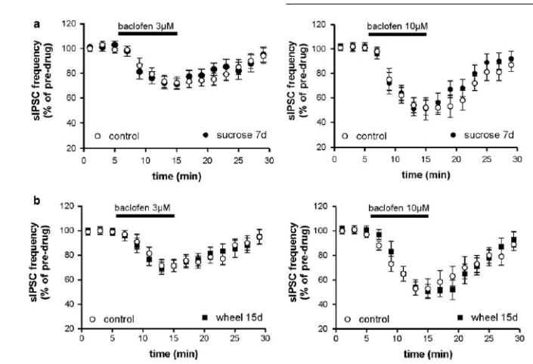
Results: Running Wheel & Sucrose on Widespread Pre-synaptic Striatal GABA Control
GABAB receptor agonist caused depressant effect similar to that of controls
Figure 6

Slide 88
Means that environmental manipulations do not result in widespread dysregulation of the presynaptic control of GABA synapses

Slide 89
But what else is going on?

Slide 90
Results: Effects of Sucrose and mGlu Receptor Agonist effects on striatum
mGlu receptor agonist reduces IPSC frequency & is potentiated w/ sucrose
Figure 7

Slide 91
Results: Effects of Sucrose and mGlu Receptor Agonist effects on striatum
CB₁ antagonist prevented depression action of mGlu receptor agonist
Figure 7

Slide 92
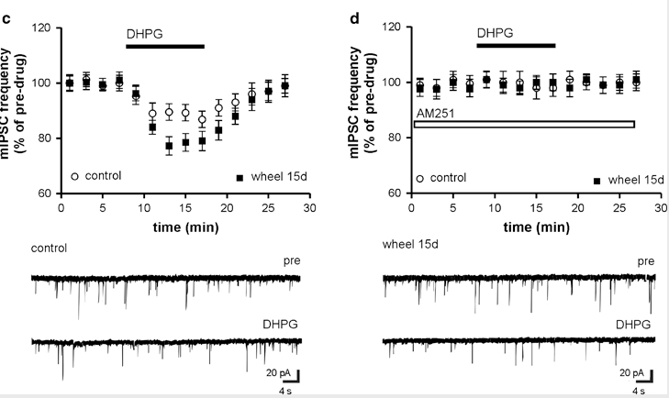
Results: Effects of Running Wheel and mGlu Receptor Agonist effects on striatum
mGlu receptor agonist reduces IPSC frequency & is potentiated w/ running wheel
Same as sucrose
Figure 7

Slide 93
Results: Effects of Running Wheel and mGlu Receptor Agonist effects on striatum
CB₁ antagonist prevented depression action of mGlu receptor agonist
Figure 7

Slide 94
So cool! This means that sucrose & running wheel can alter the endocannabinoids mobilized in response to mGlu 5 receptor stimulation. But..

Slide 95
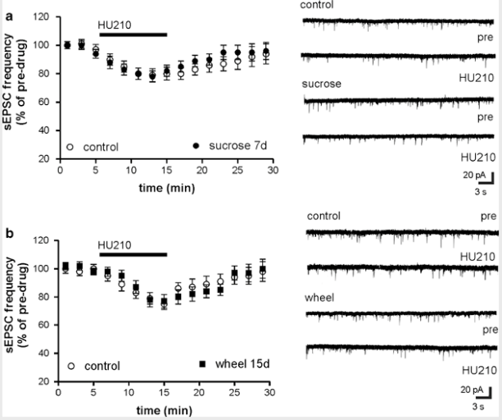
Results: CB₁ Agonist on Striatal Glutamate Transmission
Glutamate itself does not appear to be involved
Figure 8

Slide 96
How does this work into applying it to the goal of alleviated depression?

Slide 97
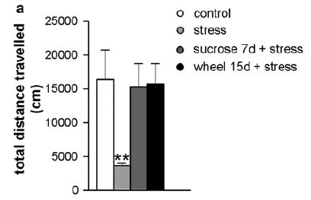
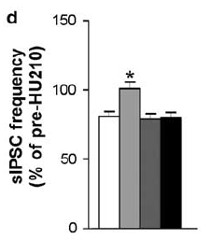
Results: Exercise/Sucrose on Stress
Exercise & Sucrose ⬇ affect of stress back to control level
Figure 9

Slide 98
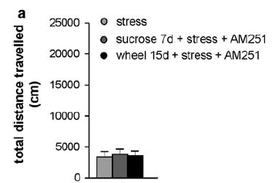
Results: Exercise/Sucrose & CB₁ antagonism on Stress
Getting rid of CB₁ causes stress to return
Figure 10

Slide 99
So we now know; 1. CB receptors adapt during environmental manipulations 2. There is differential regulation mechanisms of distinct cannabinoid receptors 3. CB₁ receptors are important to alleviate stress

Slide 100
What can be determined based on all this information?
CB₁ is important for habit formation in OFC-DS pathway
CB₁ is important to not have depression
Exercise/Sucrose can alleviate CB receptor loss in striatum via the following circuitry

Slide 101
What can be determined based on all this information?
If you have an upset in any of these→ can lead to disruptions like OCD, Depression, addiction, etc.

Slide 103
References
Cryan, J. F., Markou, A., & Lucki, I. (2002). Assessing antidepressant activity in rodents: recent developments and future needs. Trends in pharmacological sciences, 23(5), 238-245.
Dolan, R. J., & Dayan, P. (2013). Goals and habits in the brain. Neuron, 80(2), 312-325.
Fineberg, N. A., Fourie, H., Gale, T. M., & Sivakumaran, T. (2005). Comorbid depression in obsessive compulsive disorder (OCD): symptomatic differences to major depressive disorder. Journal of affective disorders, 87(2), 327-330.
Melartin, T. K., Rytsala, H. J., Leskela, U. S., Lestela-Mielonen, P. S., Sokero, T. P., & Isometsa, E. T. (2002). Current comorbidity of psychiatric disorders among DSM-IV major depressive disorder patients in psychiatric care in the Vantaa Depression Study. Journal of Clinical Psychiatry, 63(2), 126-134.
Stalnaker, T. A., Cooch, N. K., & Schoenbaum, G. (2015). What the orbitofrontal cortex does not do. Nature Neuroscience, 18(5), 620-627.
Talukdar, S., Owen, B. M., Song, P., Hernandez, G., Zhang, Y., Zhou, Y., ... & Bernardo, B. (2016). FGF21 regulates sweet and alcohol preference. Cell metabolism, 23(2), 344-349.
Verschure, P. F., Pennartz, C. M., & Pezzulo, G. (2014). The why, what, where, when and how of goal-directed choice: neuronal and computational principles. Phil. Trans. R. Soc. B, 369(1655), 20130483.

